Slide 1
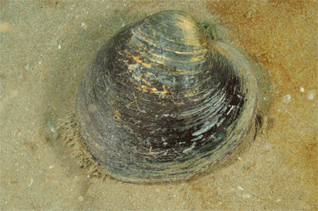
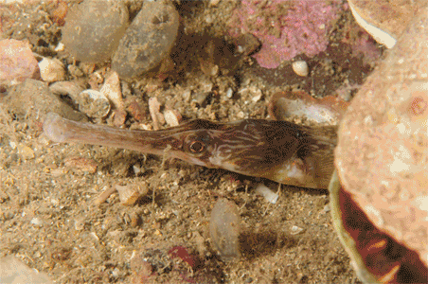
The National Marine Biological Analytical Quality Control Scheme
Set up in 1994
Source of external quality control for U.K. competent monitoring authorities; open to consultants and non-U.K. participants
Reports to the Healthy & Biological Diverse Seas Evidence Group under the U.K.’s Marine Monitoring & Assessment Strategy
Helps to standardise results and methods by providing Best Practice guides, taxonomic workshops and training exercises
Comprises a number of biological component modules
New components are developed as and when required, as determined by monitoring needs
Benthic Invertebrates
Modules:
ID Ring Tests
Own Samples
Workshops
Laboratory Reference
Manager: myles.oreilly@sepa.org.uk
Fish
Modules:
Ring Test
Workshops
Reverse Ring Test
Manager: jim.ellis@cefas.co.uk

Slide 2
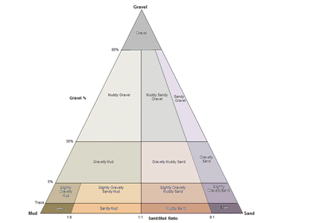
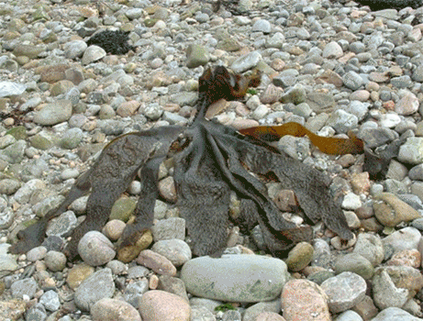
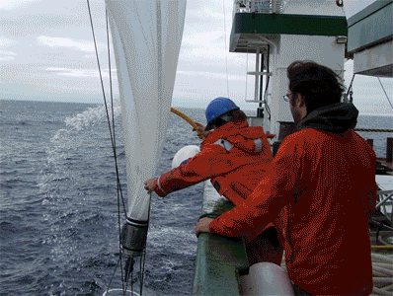
The National Marine Biological Analytical Quality Control Scheme
Particle Size Analysis
Modules:
Ring Test
Own Sample
Workshops
Manager: claire.mason@cefas.co.uk
Macroalgae & Seagrasses
Modules:
Rocky Shore Algae ID Ring Test
Opportunistic Macroalgae % Cover Ring Test
Opportunistic Macroalgae Biomass Ring Test
Seagrass % Cover Ring Test
Workshops
Manager: clare.scanlan@sepa.org.uk
Phytoplankton
Modules
Identification
Enumeration
Harmful Algal Blooms
Workshops
Manager: joe.silke@marine.ie

Slide 3
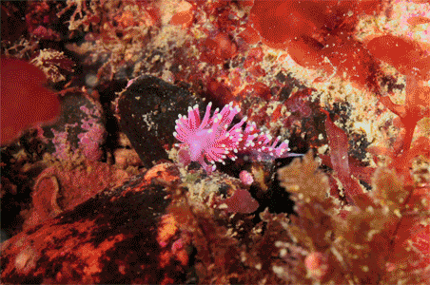
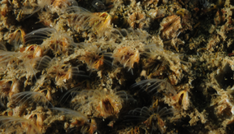
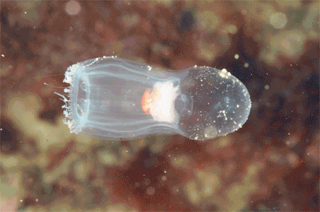
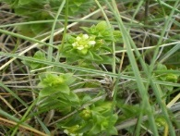
NEW - UNDER DEVELOPMENT
New elements are being brought into the scheme, currently Epibiota, Zooplankton & Saltmarsh plants
Other biological quality elements will be developed as required by monitoring needs
Epibiota
Best Practice Guide is being produced
Manager: dan.bayley@jncc.gov.uk
Saltmarsh
Saltmarsh mapping standard being produced by the Environment Agency
Saltmarsh plants ID ring test in development
Manager: clare.scanlan@sepa.org.uk
Zooplankton
Pilot Ring Test 2014/2015
Workshop 2015
Manager: david.johns@sahfos.ac.uk
The National Marine Biological Analytical Quality Control Scheme
Further information is available from the module managers
or from the NMBAQC website: http://www.nmbaqcs.org/
Technical Secretary: astrid.fischer@sahfos.ac.uk

