Slide 1
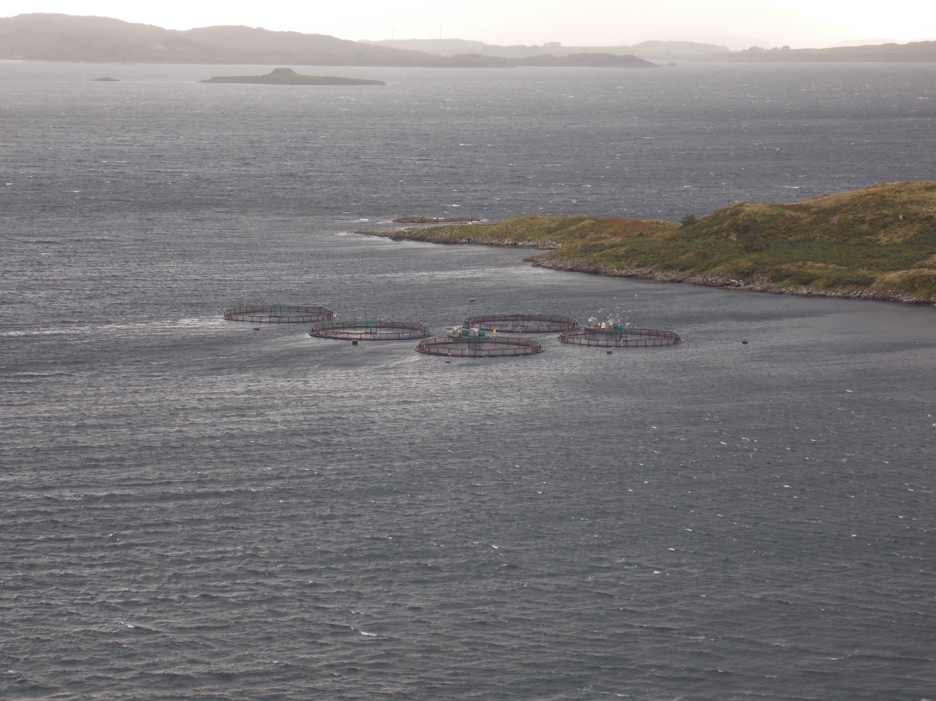
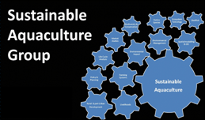
Fish Farms as Artificial Habitats for Wild Fish
Joly Ghanawi.,* Trevor Telfer, Bruce McAdam,
Institute of Aquaculture, University of Stirling, FK9 4LA, UK
*joly.ghanawi@stir.ac.uk
MASTS ASM 3-5th September, 2014

Slide 2
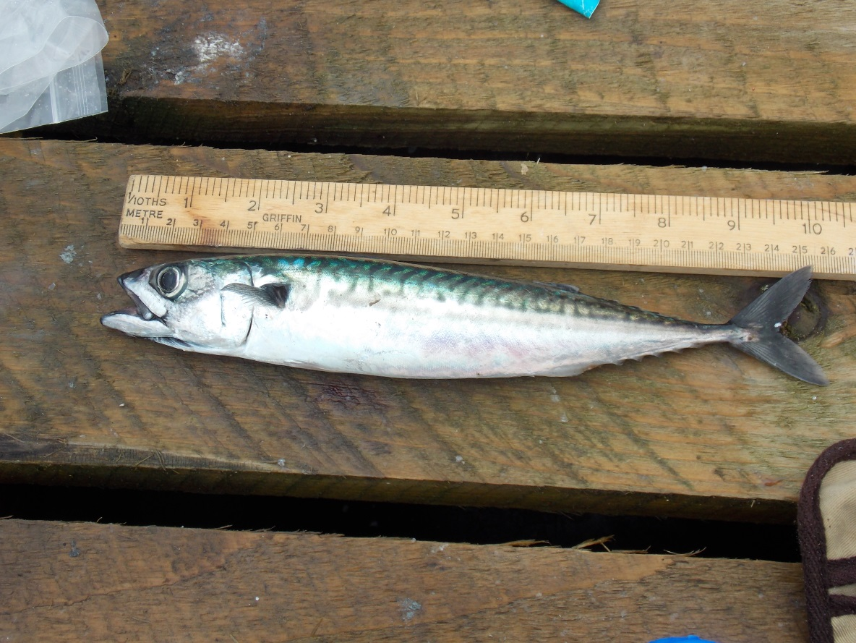
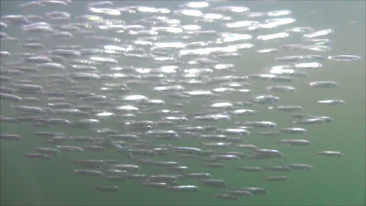
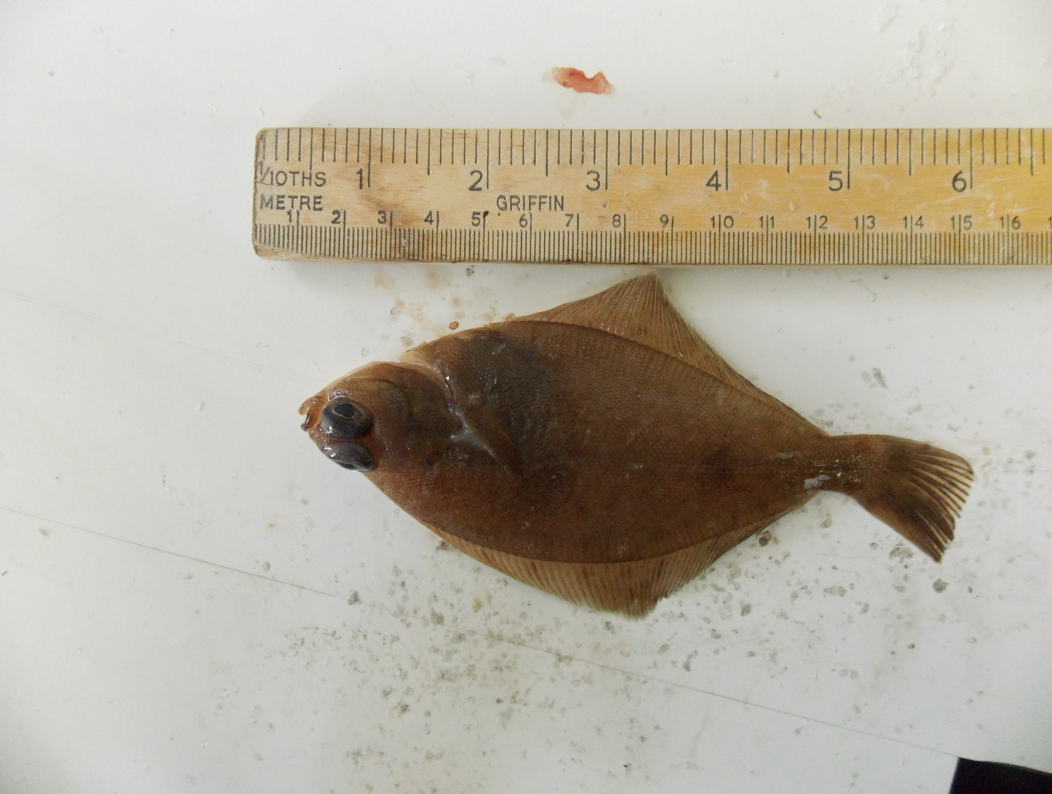
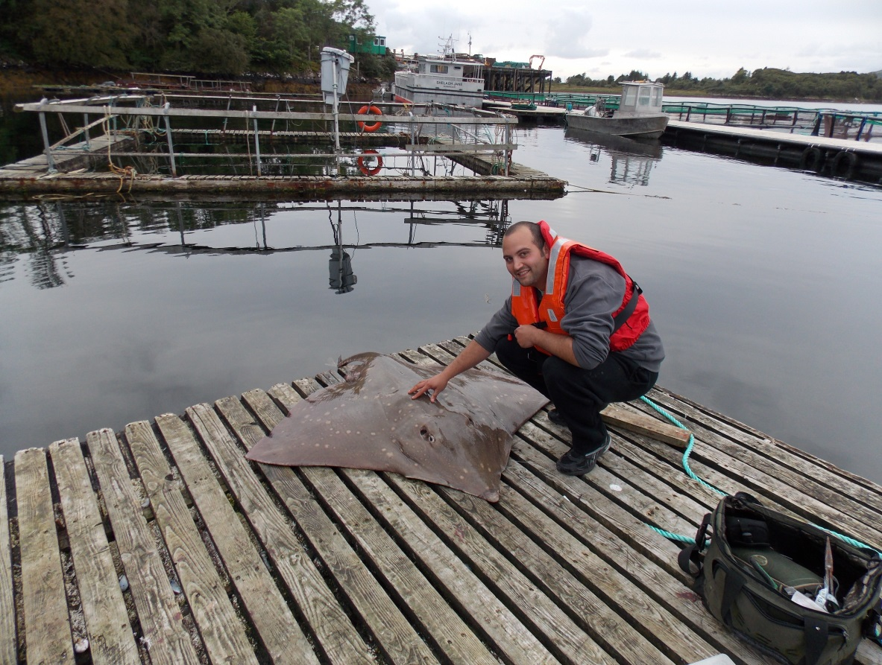
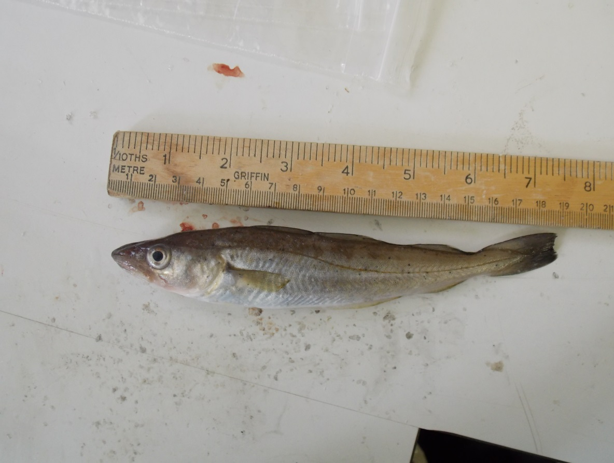
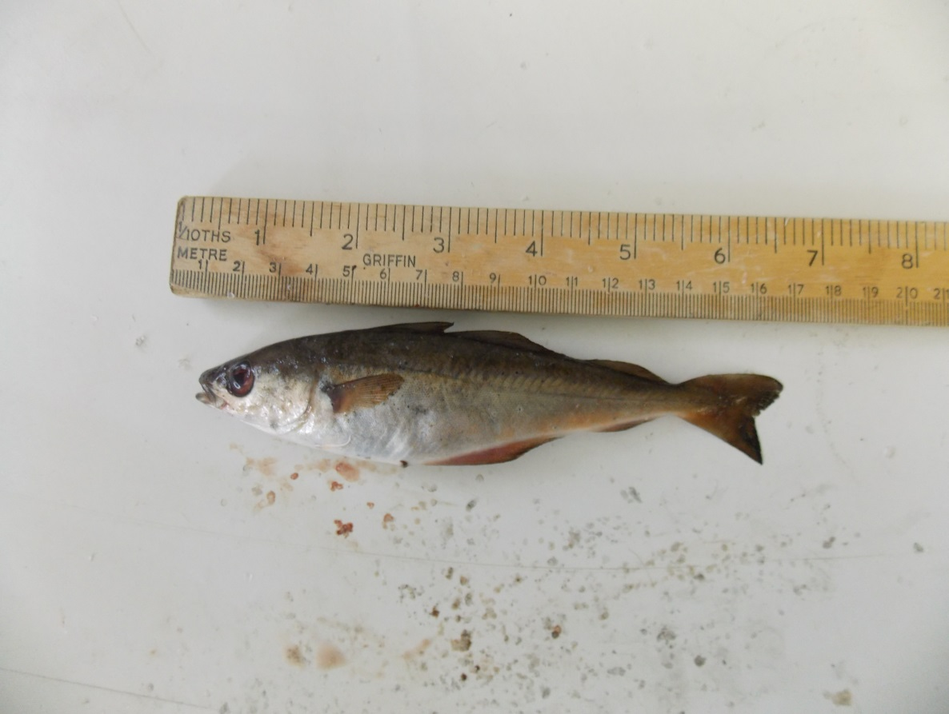
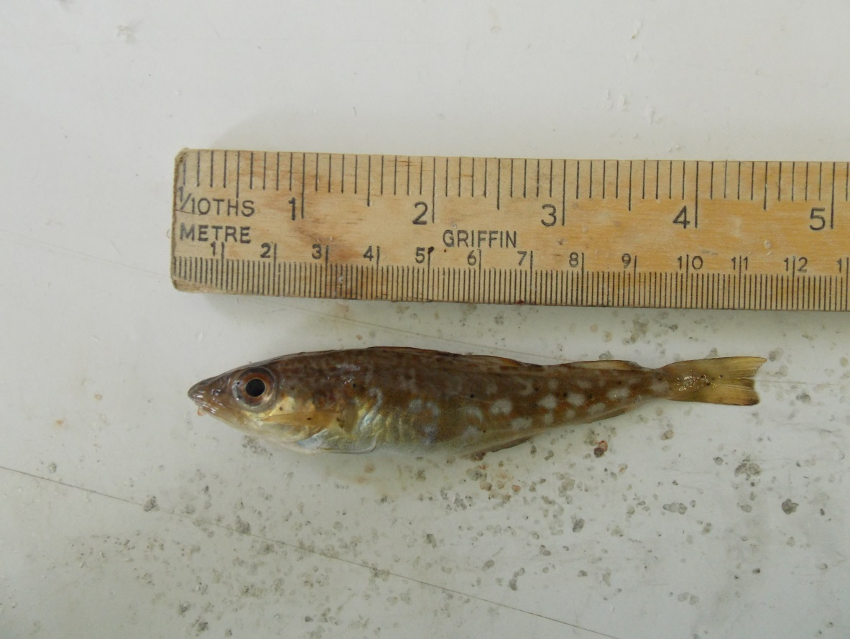
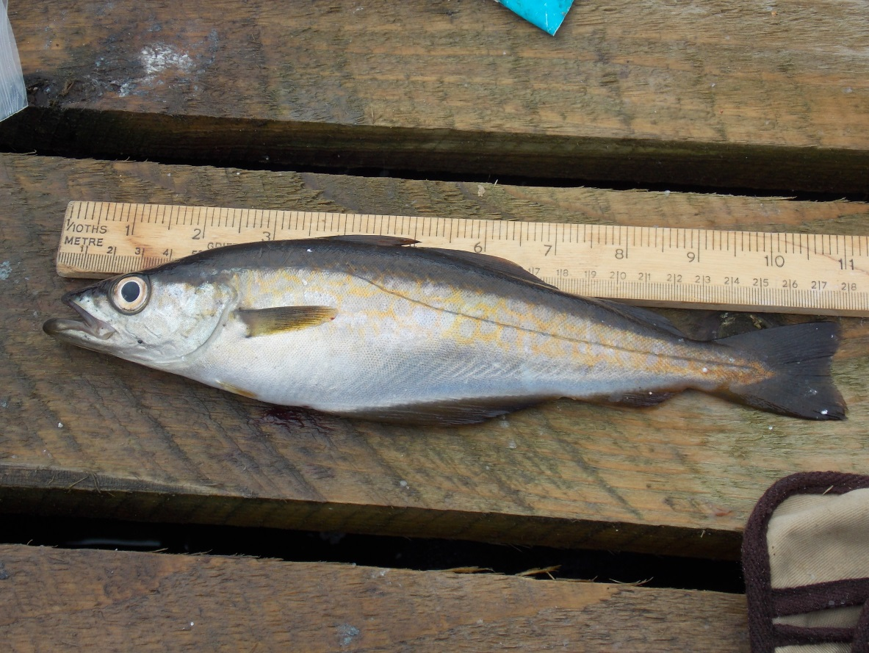
Wild Fish are Attracted to Sea Cages
Wild fish are attracted to sea cages for various reasons including protection from predators, source of food availability, meeting location and increase of eggs, larvae, and juveniles.
Growth of aquaculture in the next 40 years means we need to study the value of aquaculture as a habitat for wild organisms.
To understand these effects we are observing wild fish around a Scottish fish farm.
Some pelagic/benthopelagic/demersal species found around cages include:
Atlantic mackerel
(Scomber scombrus)
Juvenile herring
(Clupea harengus)
Juvenile dab
(Limanda limanda)
Endangered species: common skate (Dipturus batis)
Juvenile whiting
(Merlangius merlangus)
Juvenile saithe
(Pollachius virens)
Juvenile cod
(Gadus morhua)
Juvenile pollack
(Pollachius pollachius)

Slide 3
Sea cages act as artificial habitats for wild fish as they forage on commercial feed with consequences on physiology on both migrating and resident fish.
Fish collected near cages have better condition. Fatty acid profiles of both species indicated differences between fish aggregating near and away from cages (e.g. elevated levels of linoleic acid and decreased omega-3/omega-6 ratios next to cages) (* p<0.05, **p<0.01, ***p<0.001; comparison of fish fillets near and away from cages. mean ± SD (standard deviation )).
Mackerel feeding on left over pellets
 |  | Mackerel fillet |  | Saithe fillet
 | Diet of farmed fish | Next to cages | Away from cages | Next to cages | Away from cages
Length (cm) | / | 30.1±3.6*** | 22.3±1.8 | 16.6±1.4** | 19.3±1.5
Weight (g) | / | 309.82±113.12*** | 107.73±26.69 | 48.83±13.01 | 59.70±12.04
FCI | / | 1.10±0.11*** | 0.95±0.08 | 1.05±0.07*** | 0.82±0.08
HSI | / | 1.77±0.45 | 2.00±0.47 | 5.49±2.15* | 3.92±1.27
Total Lipid (%) | 21.19±0.05 | 9.72±6.10 | 5.43±2.49 | 0.98±0.08 | 1.11±0.12
Fatty Acids
Total saturated | 30.02±0.22 | 26.23±2.33* | 28.47±0.91 | 25.10±0.78 | 24.74±0.46
Total monounsaturated | 28.32±0.28 | 40.48±7.66 | 35.19±4.38 | 19.08±1.86 | 19.42±0.60
18:2n-6 | 7.22±0.02 | 3.22±3.29 | 1.22±0.31 | 2.98±0.96* | 1.91±0.41
Total n-6 PUFA | 8.95±0.06 | 5.13±3.26 | 3.13±0.64 | 7.23±0.97 | 6.33±0.87
Total n-3 PUFA | 28.66±0.45 | 27.65±7.21 | 32.72±3.58 | 48.06±1.83 | 48.89±1.02
Total PUFA | 41.66±0.49 | 33.29±7.29 | 36.34±4.14 | 55.81±1.96 | 55.85±0.79
ω3 / ω6 | 3.20±0.03 | 7.54±4.11 | 10.63±1.57 | 6.75±0.95 | 7.88±1.39
Conclusions and Further Work
Our observations show a complex artificial ecosystem associated with marine fish farming. This may be providing a safe and rich habitat for both commercially important and endangered wild fish species.
Further fieldwork will be undertaken in the summer of 2014 to confirm the present results.

