Slide 1






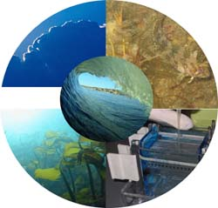
Green algae interacting with single-walled carbon nanotubes affect the feeding behaviour of mussels, mitigating nanotube toxicity
Al-Shaeri, M. A. M.^{1,2}. Paterson, L.³ Stobie, M¹ Cyphus, P.¹ Hartl, M. G. J.^{1*}
¹Heriot-Watt University, Centre for Marine Biodiversity & Biotechnology, School of Life Sciences, Riccarton, Edinburgh EH14 4AS, Scotland, UK.
²Department of Biological Sciences, Faculty of Sciences, King Abdulaziz University, Saudi Arabia.
³SUPA. Institute of Biological Chemistry, Biophysics and Bioengineering , School of Engineering, Heriot-Watt University, Edinburgh, Scotland, UK
Dr Mark Hartl’s Laboratory
Centre for Marine Biodiversity and Biotechnology
School of Life Sciences
Nano-Safety Research Group

Slide 2
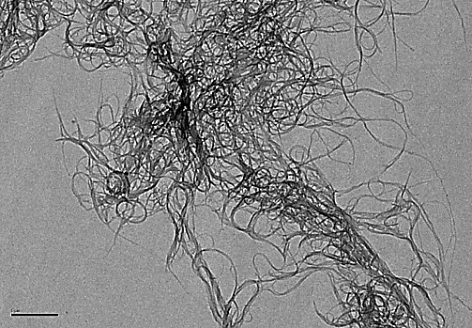
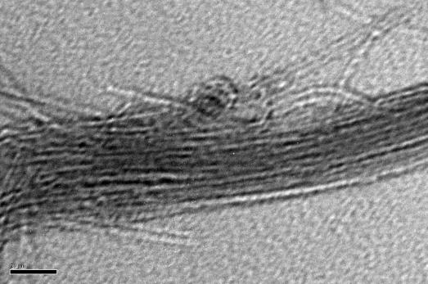
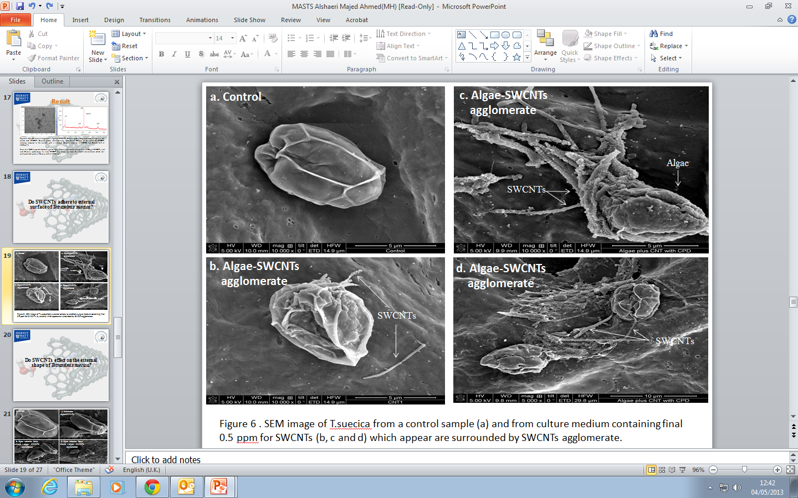
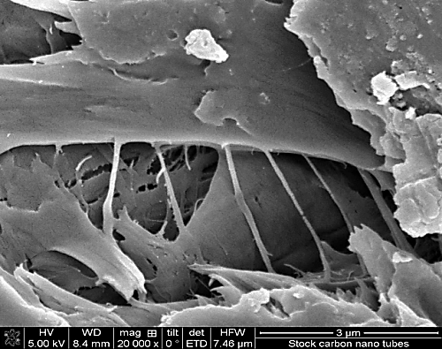
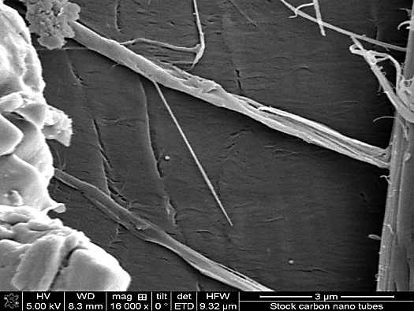
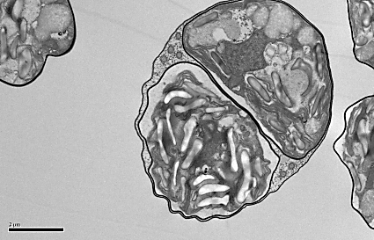
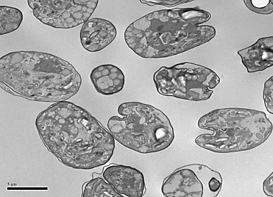
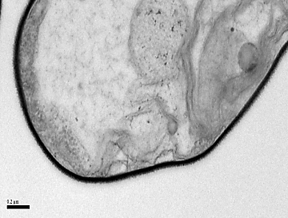

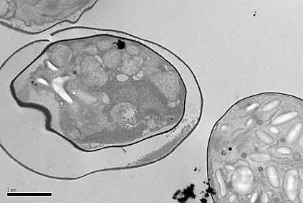
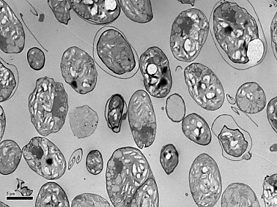
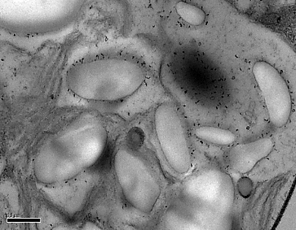
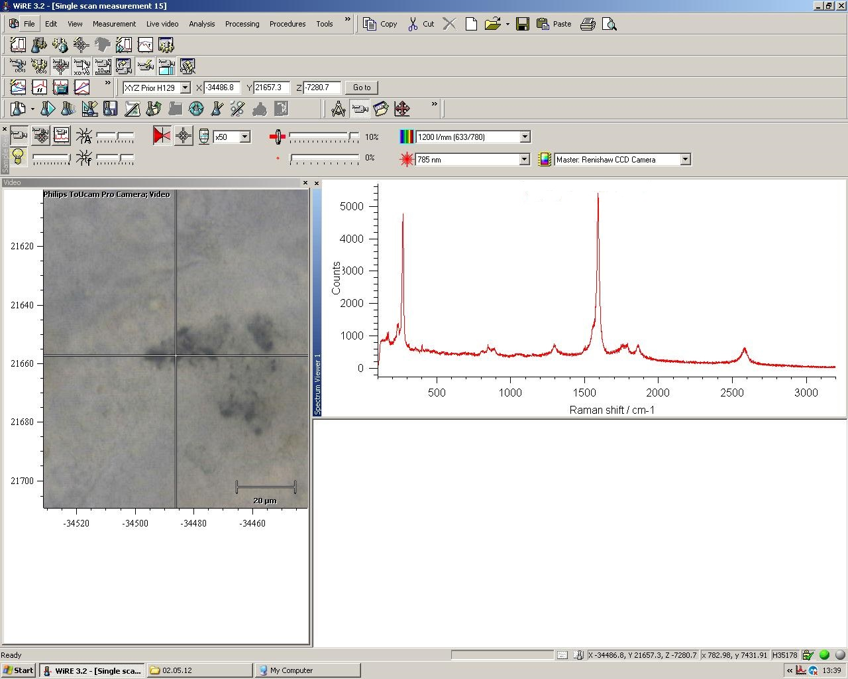
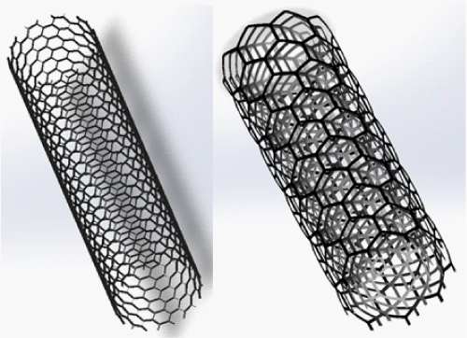
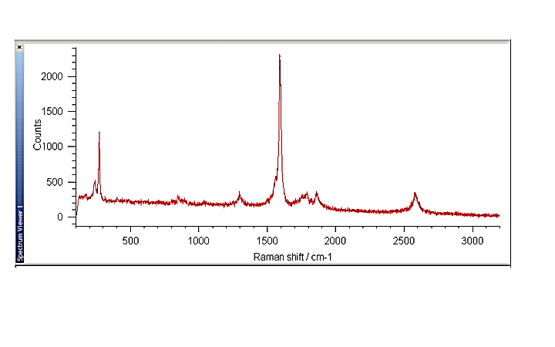
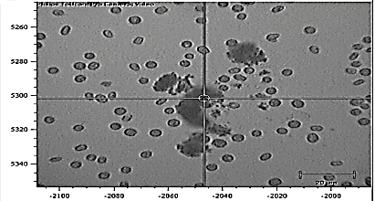
Introduction
With their high aspect ratio, strength, light weight and electrical conductivity single-walled carbon nanotubes (SWCNTs) provide properties of great interest to industry, and, consequently, are finding use in an ever increasing number of products and applications. The production, use and disposal of SWCNTs will eventually lead to their appearance in the environment [1]. Reported growth inhibition in freshwater algae has been attributed to the agglomeration of CNT on the cells and the associated secondary shading effects [2]. The aims of the present study were to determine the interaction of SWCNTs with marine algae, the effects on viability, growth and chlorophyll rate, as well as whether SWCNTs were able to enter the algal cells; To assess the affect of SWCNTs in the presence and absence algae on the feeding behaviour of mussels as well as and genotoxicity; To assess the transfer trophic of SWCNTs from algae to mussels.
Results
1. Characterization of SWCNTs
2. Algae-SWCNTs agglomerate
TEM
SEM
Fig 1. TEM micrographs of SWCNT stock preparations (1 gL⁻¹ in 0.02% SRNOM) scale bars: 1µm (left); 20nm (right).
SEM
Fig 4. SEM images of T. suecica from a control sample (a) and from culture medium containing final 500µgL⁻¹ for SWCNTs (b, c and d), which appear surrounded by SWCNT agglomerates.
TEM
A
B
C
SWCNT
Fig 2. Scanning electron microscope images of SWCNT. (a) Crystallized SWNT-SRNOM films (b) SEM images of an individual SWCNT.
Breakage in the algal cell wall
F
Raman spectroscopy
D
E
SWCNTs
Methods
Tetraselmis suecica exposed to SWCNT (diameter 1.1 nm × length 0.5–100µm; Sigma–Aldrich; Fig. 1).
TEM, SEM and Raman spectroscopy and DLS for SWCNT characterization.
Raman spectroscopy, SEM and TEM were used to detect SWCNT-algal interaction.
Flow cytometry used to monitor algal cell viability and algal cell pseudofaeces.
Algal growth and chlorophyll rate determined using an improved Neubauer haemocytometre and fluorometer.
Comet assay used to assess the genotoxicity of SWCNT on mussel in the presence algae
Histological observation was used to determine the trophic transferee of SWCNT from algae to mussel.
Plasma membrane damage
G-band
SWCNTs
SWCNTs
RBM
G⁺
D-band
Fig 5A, B and C: TEM images of control cells with intact cell wall and plasma membrane; Fig 6D ,E and F show cells exposed to 500µgL⁻¹ SWCNTs. Cell wall breakage ; plasmolysis ; internalization of the SWCNTs .
G⁻
Gˊ-band
Fig 3. Spectrum from SWCNTs stock clearly shows the characteristic peaks of SWCNTs: radial breathing mode (RBM) at 268 cm⁻¹, D band at 1290 cm⁻¹, G band at 1590 cm⁻¹, and Gˊ band at 2585 cm⁻¹.
Raman spectroscopy
1590 cm⁻¹
DLS & Zeta potential
Table 1. Single-walled carbon nanotube (SWCNT) characterization: Zeta potential
268 cm⁻¹
SWCNT (µgL⁻¹⁾ | Zeta potential (water) | Zeta potentialª (seawater) | DLS (nm) | Zeta potential (%0.02 SRNOM)
5 | –2.95 | –8.84 | 475 | -12.24
10 | –4.49 | –10.83 | 1384
50 | –7.75 | –10.13 | 1740
100 | –5.25 | –15.93 | 4982
500 | –6.86 | –13.73 | 6206
1290 cm⁻¹
2585 cm⁻¹
Fig 6. Raman spectra of Algal-SWCNT interaction following 24h exposure of algae to SWCNTs (100μL-1). The peaks observed at excitation 785 nm are characteristic of SWCNTs: RBM at 268cm-1, D band at 1290 cm-1, G band at 1590cm-1 and the G’ band at 2585 cm-1.
ªpH 8.4, salinity 32 (±1) ‰
DLS= Dynamic light scattering .

Slide 3
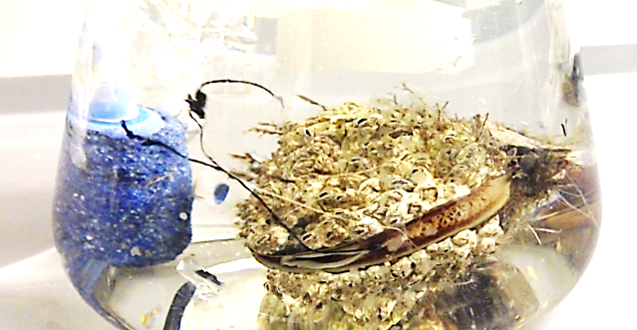
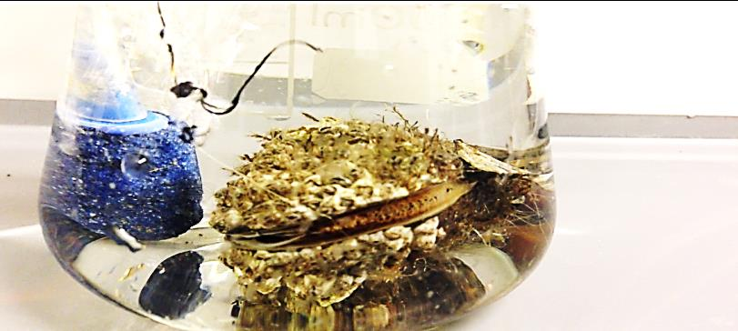
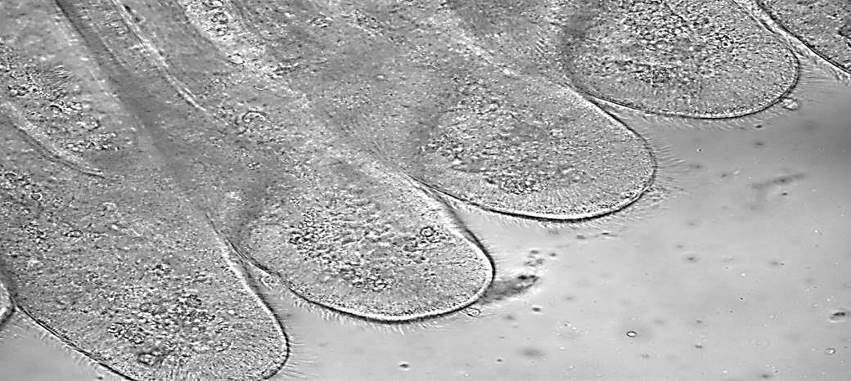
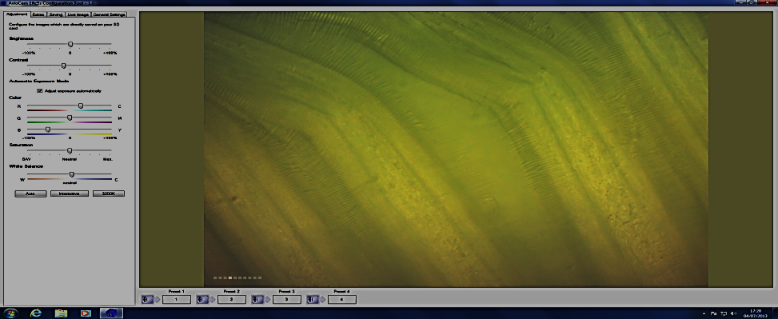
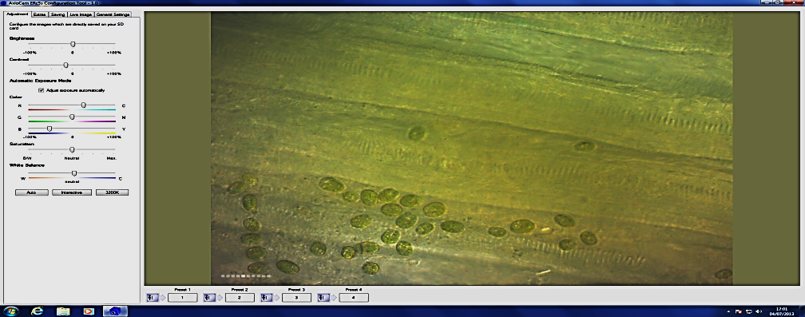
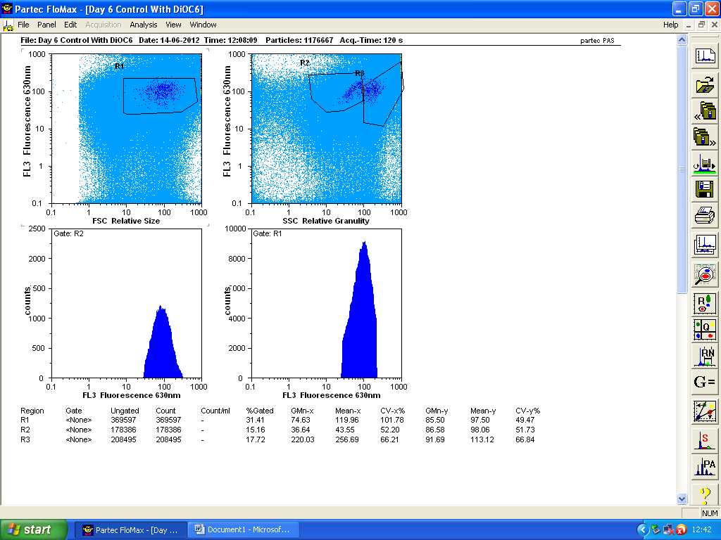
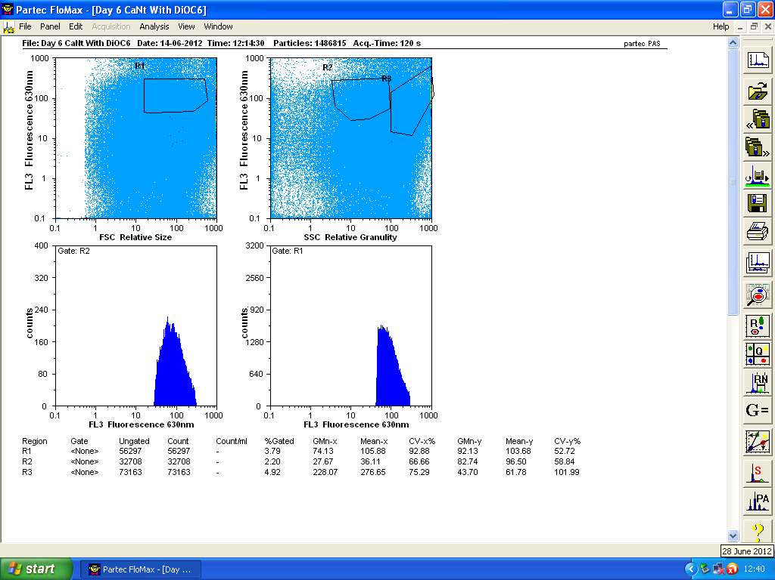
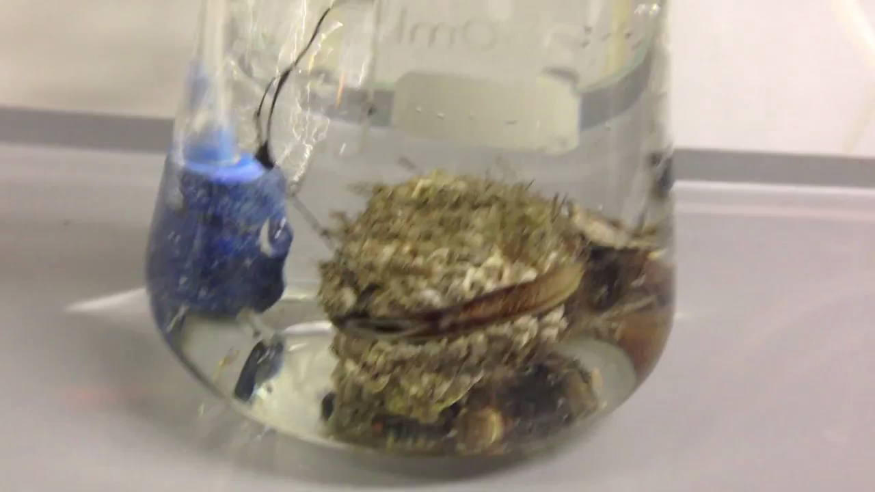
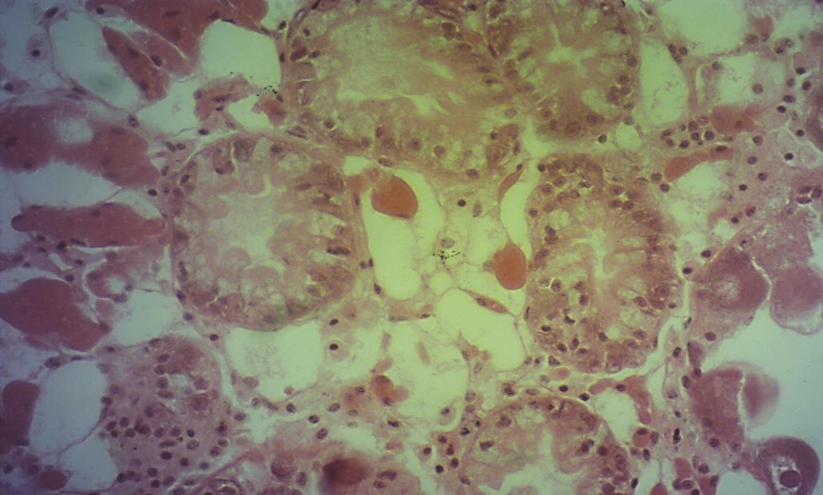
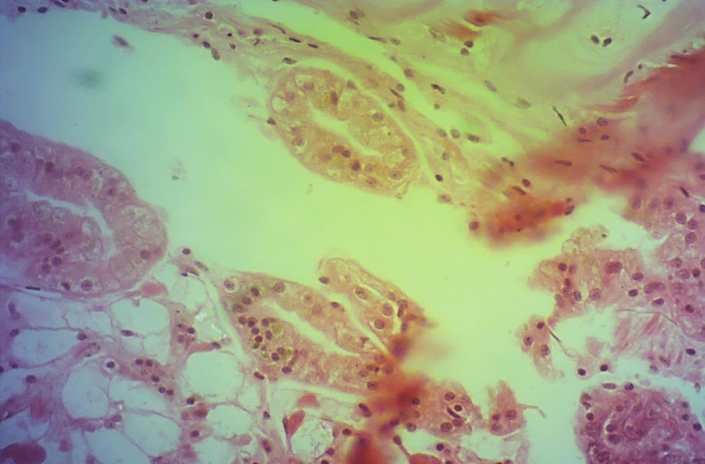
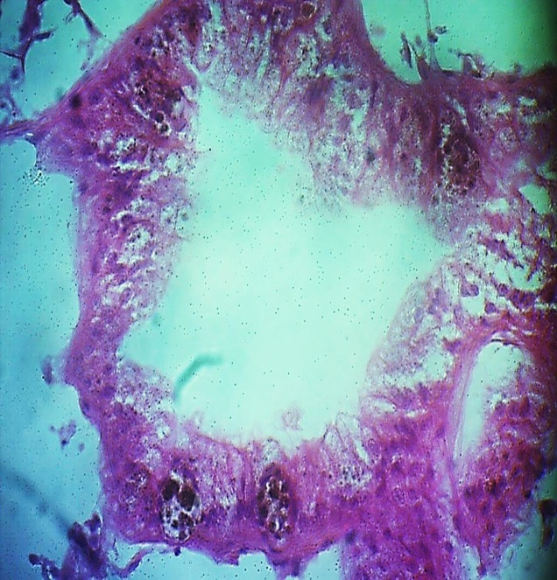
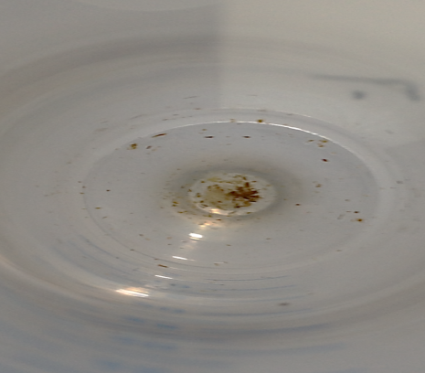
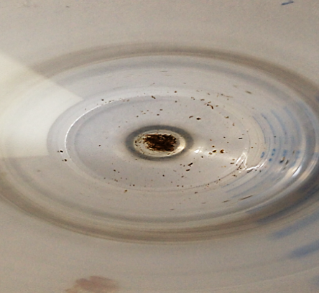
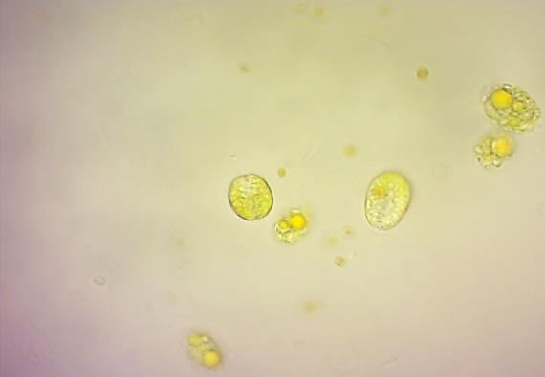
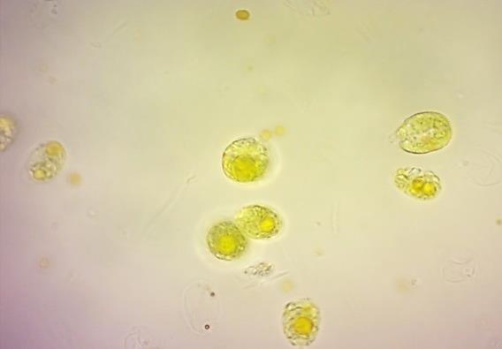
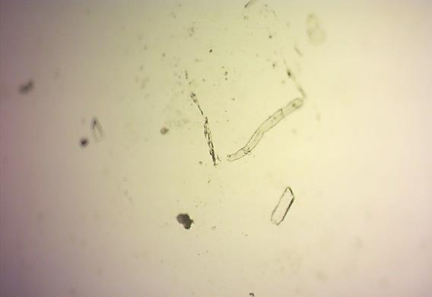
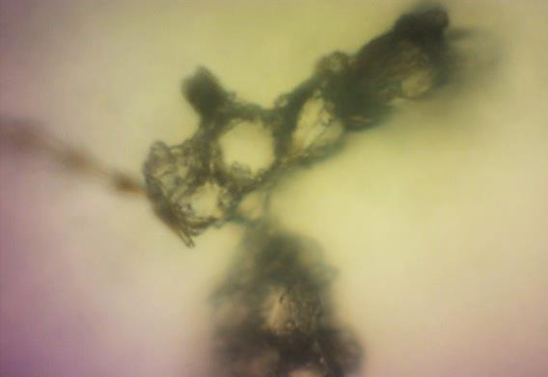
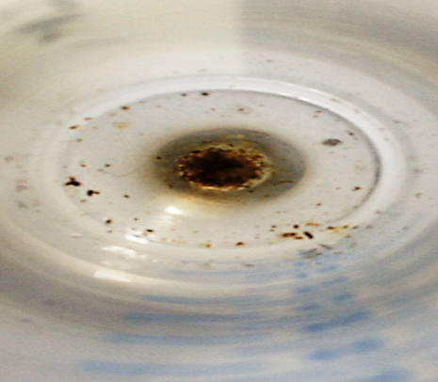
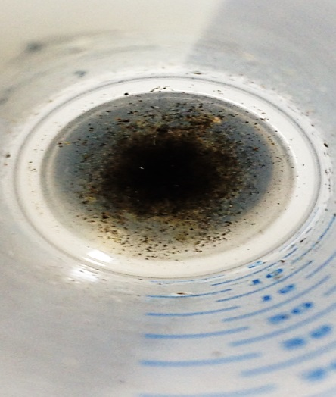
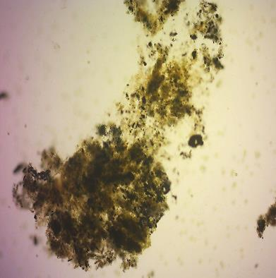
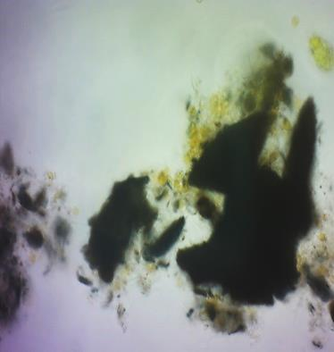
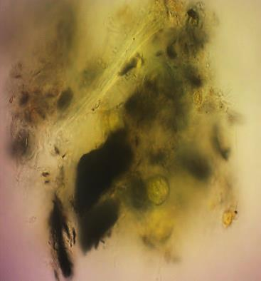
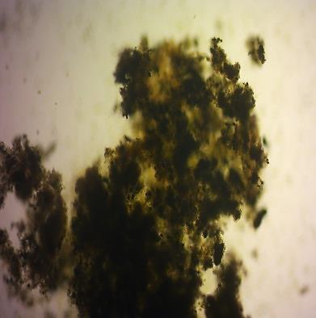
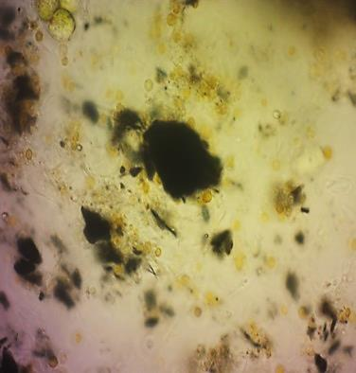
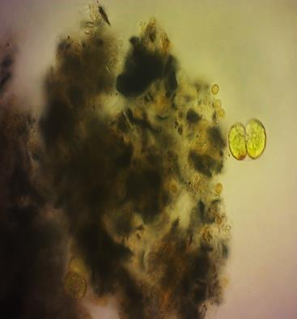
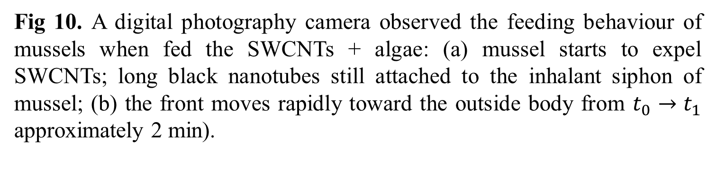
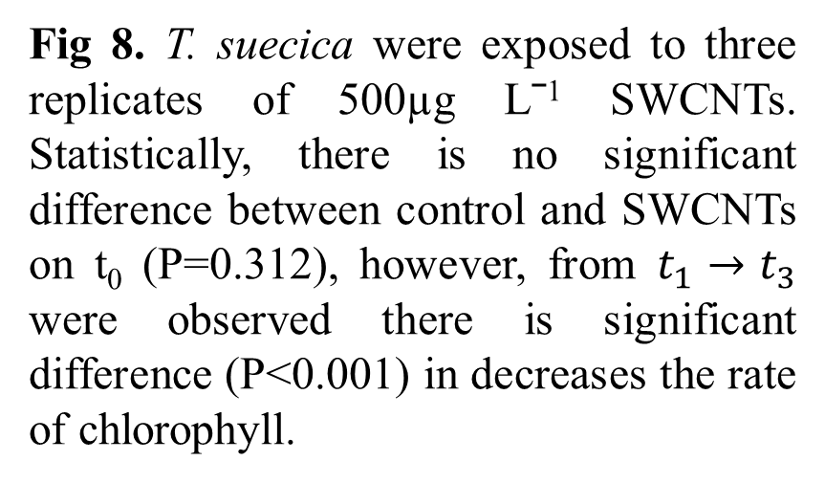
3. Food behaviour of mussels, mitigating nanotube toxicity
Algal cell viability
Mussel expels SWCNT in the presence of algae
Trophic transfer of SWCNT from algae to mussel
a
SWCNT
b
Expelled SWCNT
A
B
C
Cilia
Epithelium gill
Fig 16. A digital photography-camera correlated with a light microscope shows (E) cilia on the gill epithelia that can be used for capturing food or other substances. (B) control epithelium gill mesh, Figure (C) show the preliminary observation of physical interaction between algae contains SWCNTs and mussels.
Fig 13. Flow cytometry shows the number of the pseudofaecal algal cells produced by mussels, which have been shown to produce a copious pseudofaecal algal cells in the presence of SWCNTs., Statistically, significantly increased pseudofaeces production (P=0.008) under combined algae and SWCNT exposure.
C
A
Control
B
Fig 10. A digital photography camera observed the feeding behaviour of mussels when fed the SWCNTs + algae: (a) mussel starts to expel SWCNTs; long black nanotubes still attached to the inhalant siphon of mussel; (b) the front moves rapidly toward the outside body from $t_{0}→t_{1}$ approximately 2 min).
Fig 7. Peaks (left) control and (right) 500µgLˉ¹ SWCNT show the viable T. suecica cells using Cyflow. Statistically, there is a significant difference between 500µgLˉ¹ SWCNT and control groups (P<0.001) ANOVA.
Fig 8. T. suecica were exposed to three replicates of 500µg Lˉ¹ SWCNTs. Statistically, there is no significant difference between control and SWCNTs on t₀ (P=0.312), however, from $t_{1}→t_{3}$ were observed there is significant difference (P<0.001) in decreases the rate of chlorophyll.
Algae mitigates the genotoxicity of SWCNTs
Digestive algal cells
500µgL⁻¹ SWCNTs + Algae (DNA damage in gill)
500µgL⁻¹ SWCNTs + Algae (A)
SWCNTs
*
Observation faecal and pseudofaecal algae and SWCNT
Fig 17. The gut from mussels exposed to algal cells-SWCNT 500µg Lˉ¹. Histological sections of the mussel's gut in (A) control tissue, (B) digested algal cells including SWCNTs which have already been shown inside algal cells via TEM , ad (C) SWCNTs in gut. In this assay mussels were left to feed for 10 minutes.
A
B
A
B
% DNA in Tail
*
C
D
Conclusions
SEM confirmed the shading effect of SWCNTs on algal cells (Fig 4).
SWCNTs appeared to be able to enter the algal cells (Fig 5D,E and F).
Control algae remained mitotic, whereas those incubated with SWCNTs (500µgL⁻¹) showed a loss of cellular integrity, indicating irreversible cell damage (Fig 5D).
Raman spectroscopy confirmed SWCNT cover algal cells (Fig 6).
Algal cell viability (Fig 7), Chlorophyll rate (Fig 8) and growth rates (Figure 9) were affected by SWCNTs ≥ 100µgL⁻¹.
Mussel can expels a copious pseudofaecal material expelled by the inhalant siphon when fed the SWCNTs with algae (Fig10-12).
The presence of SWCNTs in the food are able to effect the feeding behaviour of mussel (Fig 13).
The toxicity of SWCNTs can be mitigated when mussels fed algae with SWCNTs (Fig 14-15).
SWCNTs are seen able to trophic transfer from alga to mussel (Fig16-17).
500µgL⁻¹ SWCNTs + Algae (DNA damage in haemocytes)
500µgL⁻¹ SWCNTs + Algae (B)
*
E
F
G
*
C
D
H
I
J
Fig 11. Feeding behaviour of the mussel. (A,B) Faecal material expelled by the exhalant siphon of the mussel when fed the T. suecica alone. (C) Pseudofaecal material expelled by the inhalant siphon of the mussels when fed the SWCNTs 500µgLˉ¹. (D) Copious pseudofaecal material expelled by the inhalant siphon of the mussel when fed the SWCNTs with T. suecica.
Fig 12. Faecal and pseudofaecal algal cells were observed clearly by optical microscopy. (A, B) faecal algal cells in the absence of SWCNTs, (C, D) Pseudofaecal material expelled by the inhalant siphon of the mussels when fed the SWCNTs 500µgLˉ¹ alone, while (E-J) copious pseudofaecal algal cells and SWCNTs expelled by the inhalant siphon of the mussel when fed the SWCNTs with T. suecica.
Fig 14. Mussels were fed algae, SWCNT 500µgLˉ¹ alone and algae + SWCNTs for 24h. * signiﬁcantly different from control, algae and algae + SWCNTs (P<0.001).
Fig 15. Mussels were fed algae, SWCNT 500µgLˉ¹ alone and algae + SWCNTs for 24h. * signiﬁcantly different from control, algae and algae + SWCNTs (P<0.001).
Fig 9. T. suecica were exposed to SRNOM and SWCNTs at nominal concentrations (5µgLˉ¹, 10µgLˉ¹, 50µgLˉ¹, 100µgLˉ¹, and 500µgLˉ¹) for 8 days. Statistically, there was no significant difference between SRNOM, ≤50µgLˉ¹ SWCNTs and control groups; however, significant growth inhibition occurred ≥100µgLˉ¹ (P<0.001).
References
[1]Al‐Shaeri, Majed, et al. "Potentiating toxicological interaction of single‐walled carbon nanotubes with dissolved metals." Environmental Toxicology and Chemistry 32.12 (2013): 2701-2710.
[2] Schwab, F., Bucheli, T. D., Lukhele, L. P., Magrez, A., Nowack, B., Sigg, L. & Knauer, K. 2011.Environmental science & technology.

