Slide 1


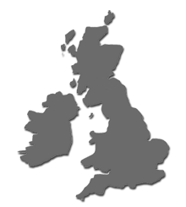
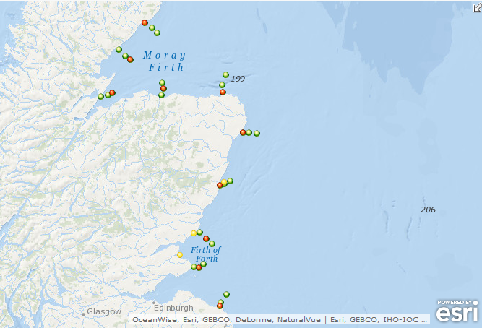
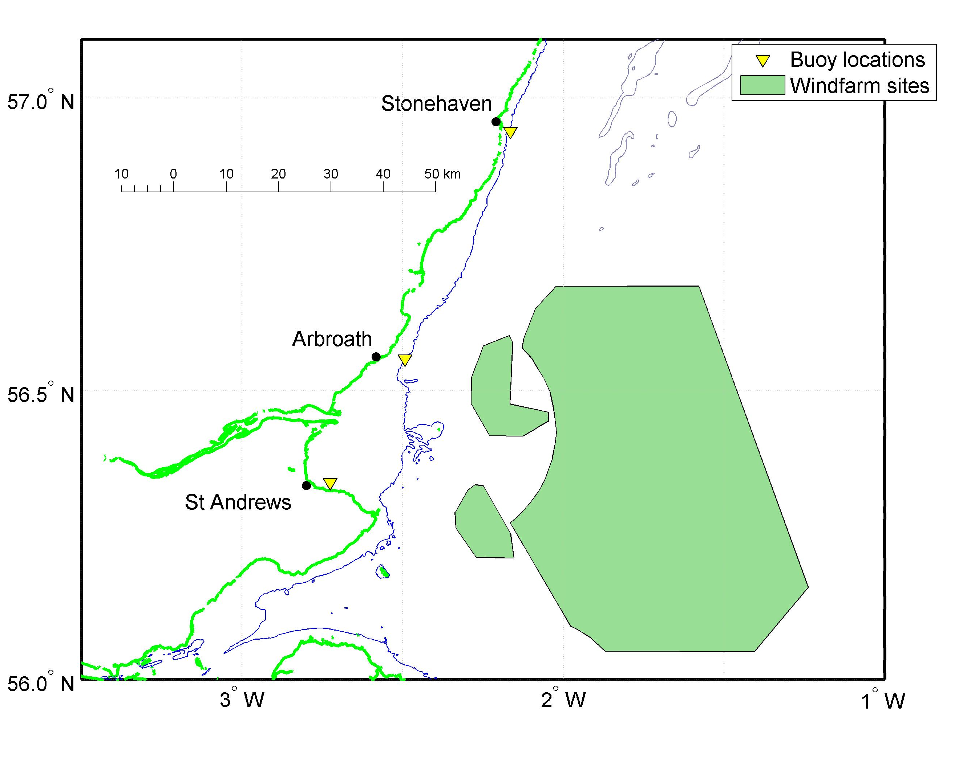
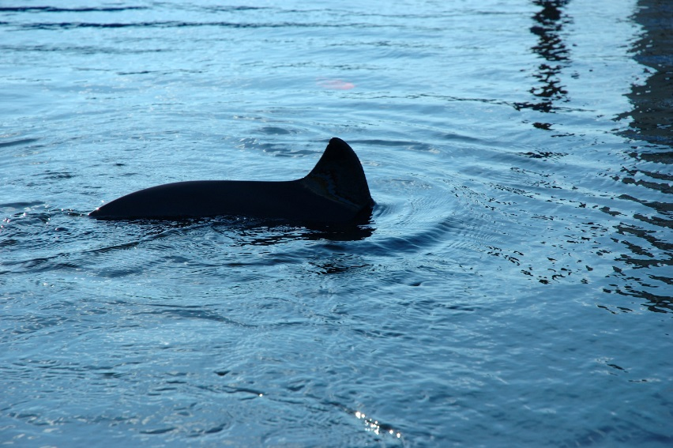
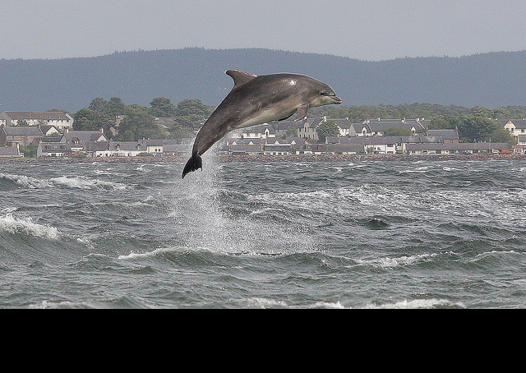

East coast marine mammal acoustic study: using multiple modalities to assess habitat usage by harbour porpoises and bottlenose dolphins
Introduction
K.J. Palmer^{(1)*}, Dr. Kate Brookes⁽²⁾, Dr. Luke Rendell⁽¹⁾
(1) Sea Mammal Research Unit, Scottish Oceans Institute, University of St Andrews
(2) Marine Scotland: Science
* kp37@st-andrews.ac.uk
Introduction
Planned Wind Farm Locations
Acoustic Study Sites
Major investments in offshore wind power are planned around Scotland in the coming years and particularly on the east coast of Scotland. Due to potential noise emissions associated with the development work, there is a need to effectively monitor the impact of the installation and operation of the wind turbines on marine mammals. Passive acoustic monitoring provides a way to meet this need.
Lat
Hel
Cro
Spe
Fra
Cru
Sto
Target Species
Abr
StA
Stb
CPODs (green dots), SM2Ms (red dots) and PAMBuoys (yellow dots) along
Harbour Porpoise (Phocoena phocoena)
Bottlenose Dolphin (Tursiops truncatus)

Slide 2

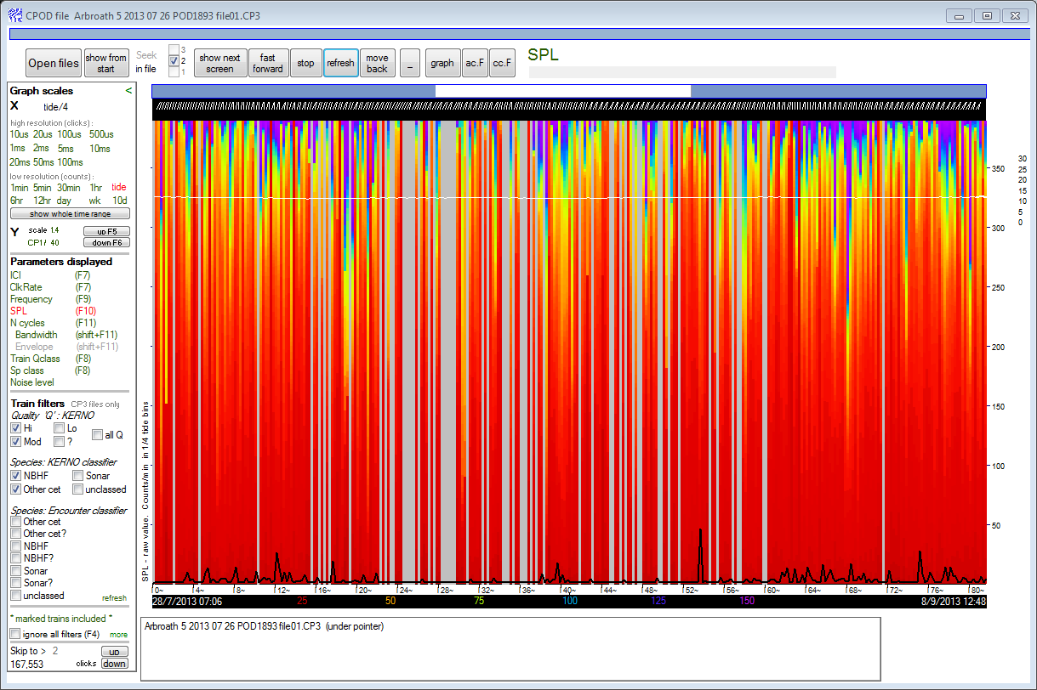
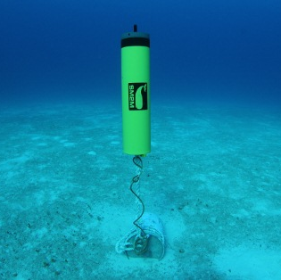
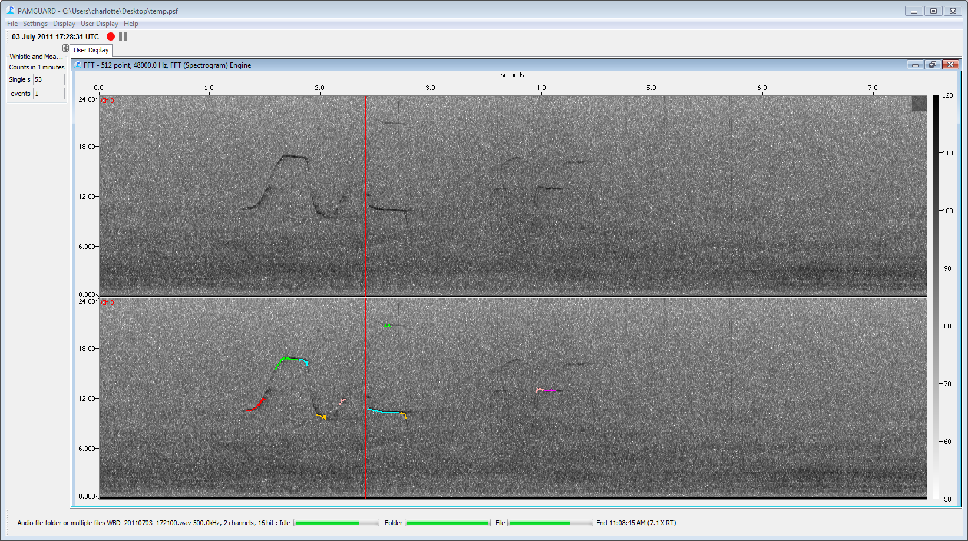
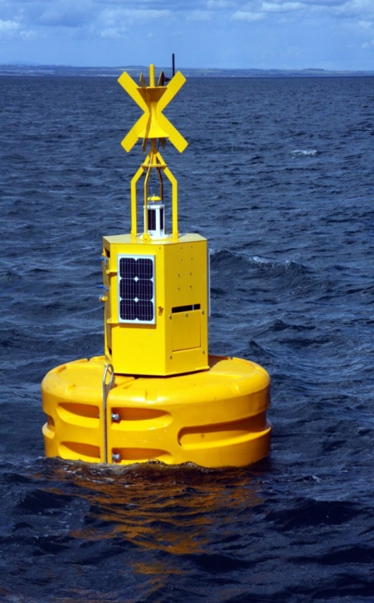
Materials
Archival Data Sources
C-POD/SM2M Deployment Duration (Year 1 of 4)
C-PODs
30 Units
Continuous monitoring
dolphin/porpoise positive time
SM2Ms
10 SM2Ms
Duty-cycled
Acoustic Data
96 kHz Sample Rate
Real-Time Acoustic Data
PAMBuoy
3 PAMBuoys
Continuous strategic acoustic monitoring
Timed recordings
Dolphin whistle contour extractions
Ambient noise levels
Temporal coverage of CPODs (green) and SM2Ms (red) data from the first year of the acoustic study. Our challenge will be to integrate these disparate data sources in order to gain meaningful insights to habitat selection of protected bottlenose dolphins and harbor porpoises.

Slide 3
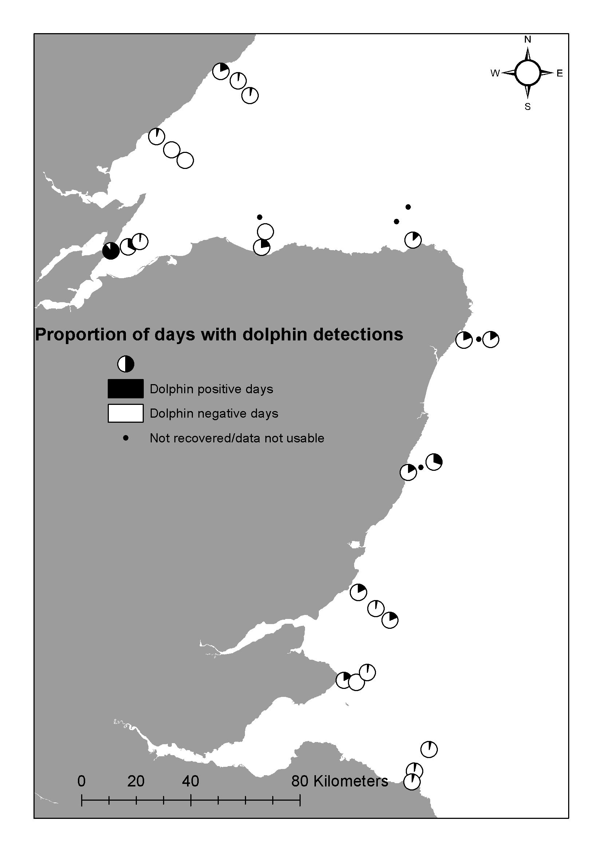
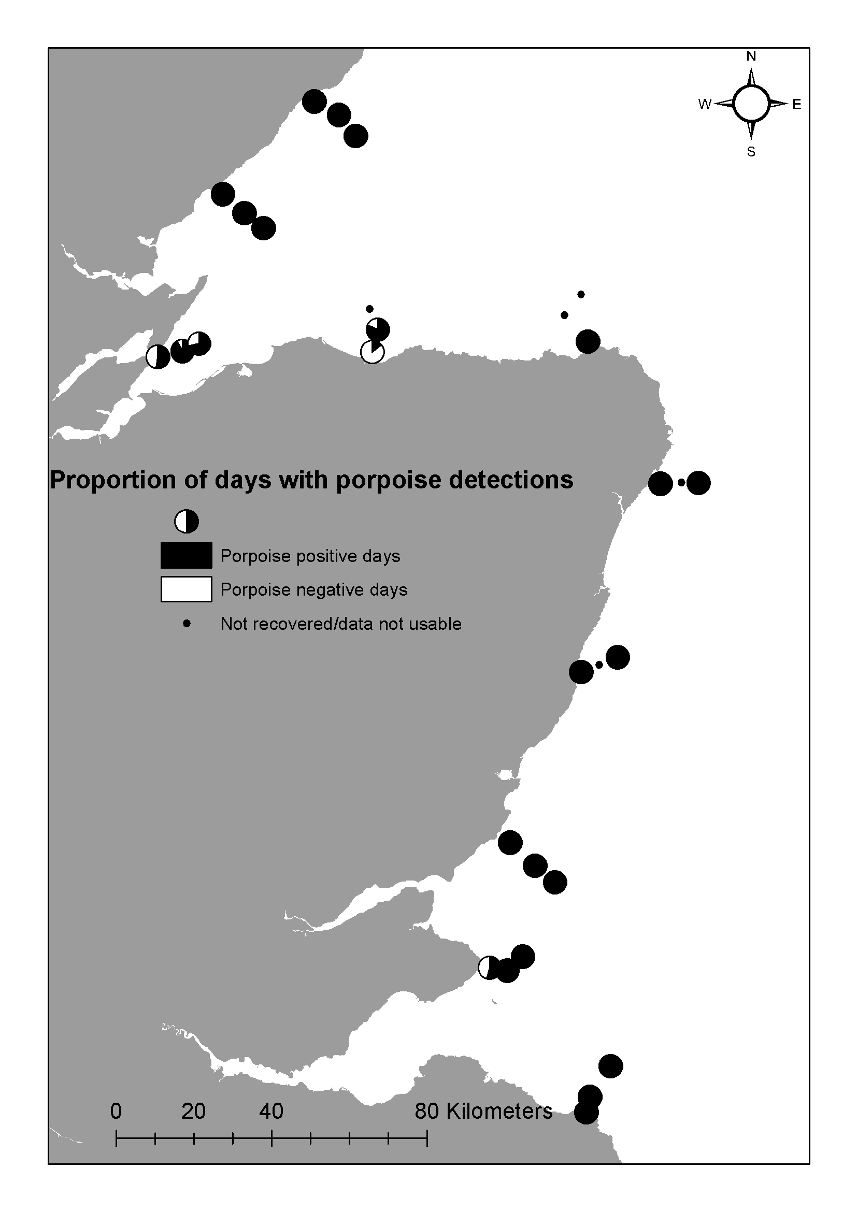
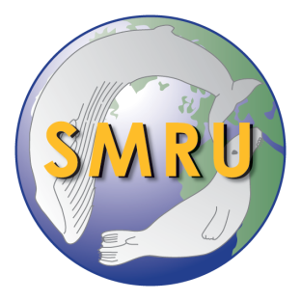





Preliminary CPOD Results
Future Aims and Objectives
Determine baseline habitat use by bottlenose dolphins and harbour porpoises along the East Scottish Coast
Determine ambient noise levels at 11 deployment locations
Develop analysis methods for processing high volume acoustic data
Track individual bottlenose dolphins based on signature whistles
Acknowledgements
This work was co-sponsored by the University of St. Andrews School of Biology and Marine Scotland. This work received funding from the MASTS pooling initiative (The Marine Alliance for Science and Technology for Scotland) and their support is gratefully acknowledged. MASTS is funded by the Scottish Funding Council (grant reference HR09011) and contributing institutions. PAMBuoys were supported by the Crown Estate and Scottish Enterprise. We are grateful to Moray First Marine, the crew of the Northern Lighthouse Board’s Polestar, the crew of the RV Alba na Mara, and Marine Scotland Science staff for deploying and recovering the archival units.

