Slide 1
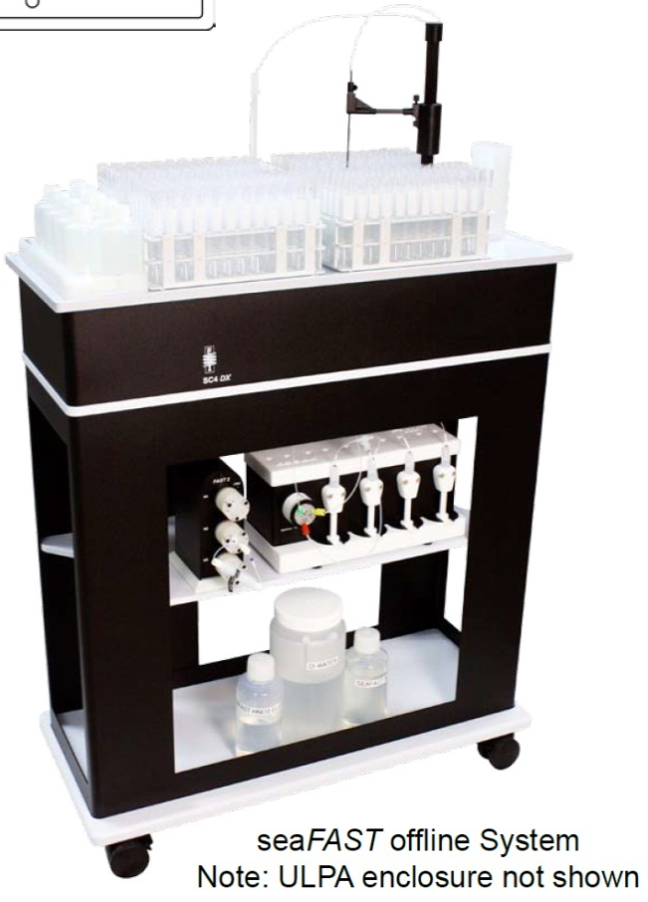
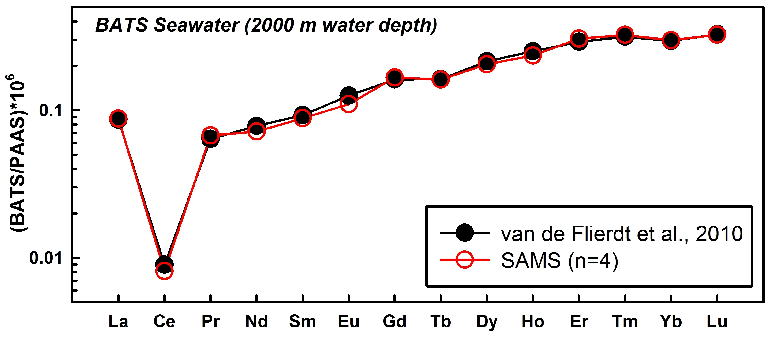
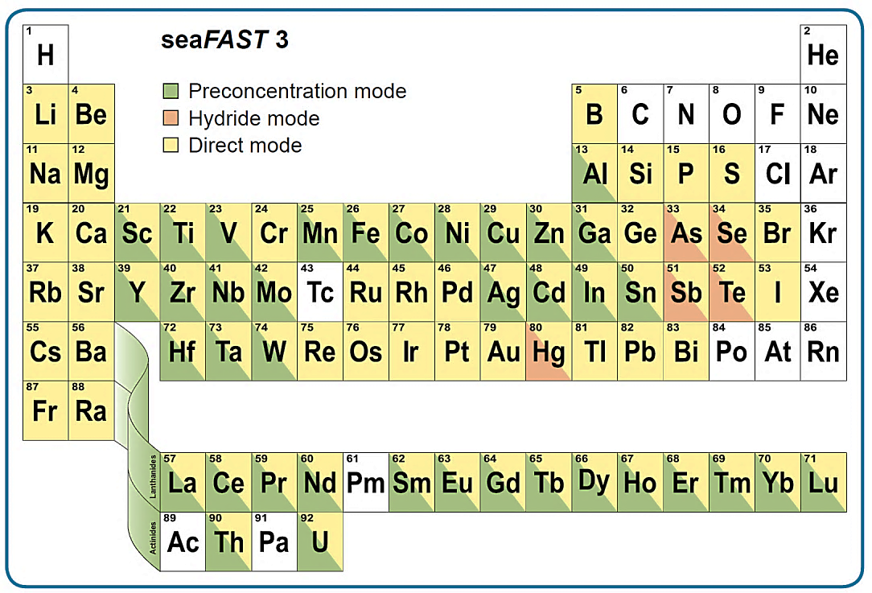
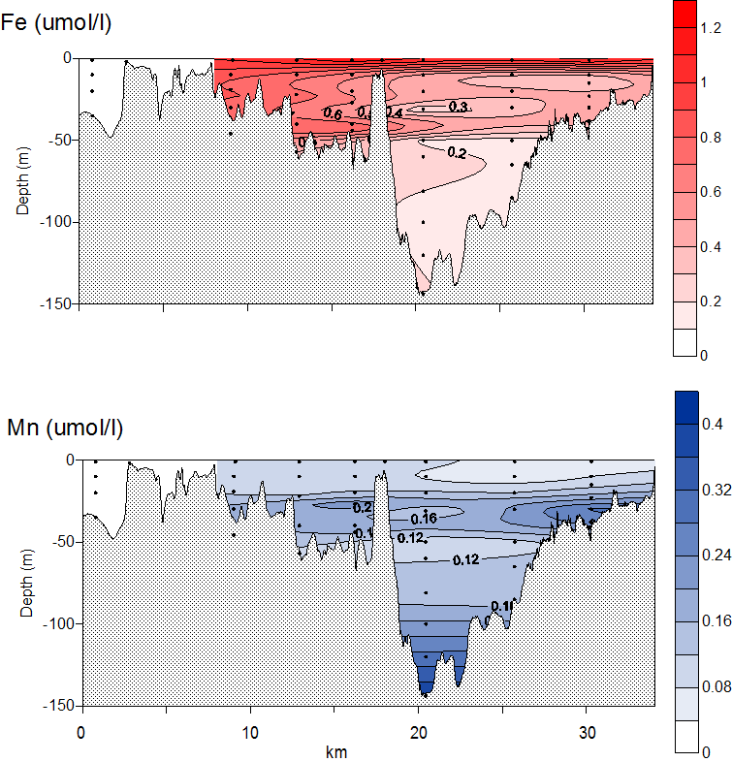
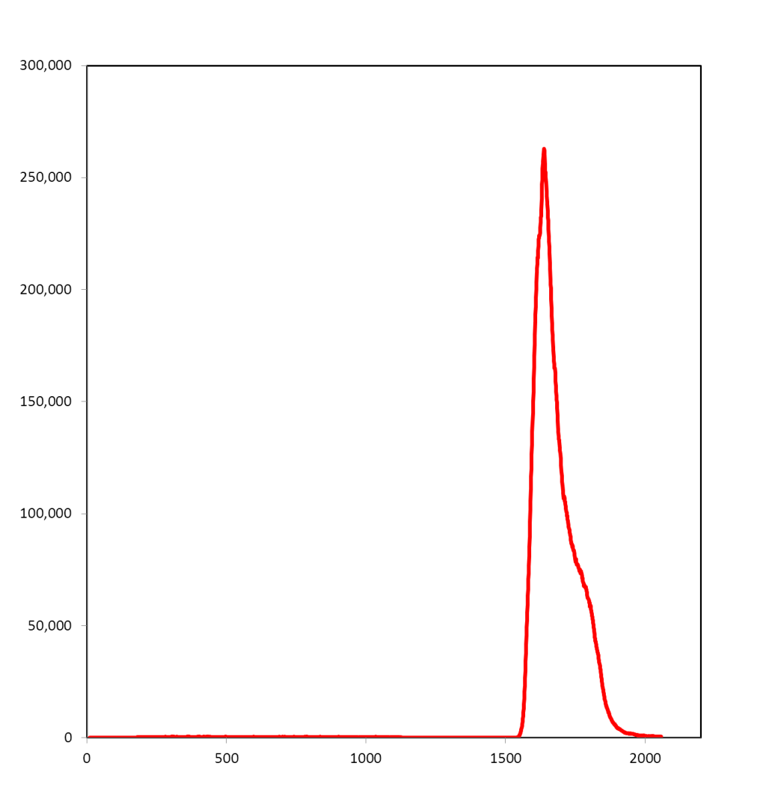
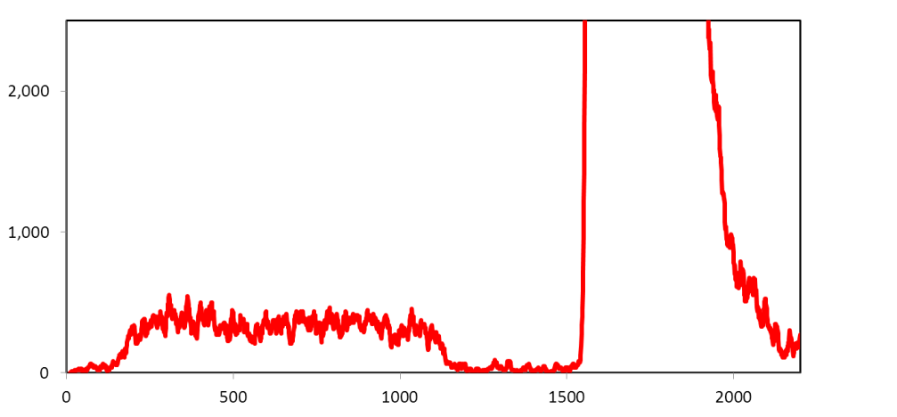
New developments in seawater trace metal analysis at SAMS: Automated preconcentration by SeaFAST Pico
1. Scottish Association for Marine Science, Scottish Marine Institute, Oban, Scotland, UK
Tim Brand¹ (tim.brand@sams.ac.uk), Kirsty Crocket¹, Richard Abell¹, John Howe¹, Ed Hathorne²
1. SAMS, Scottish Marine Institute, Oban, Scotland, UK. 2. GEOMAR, Helmholtz Centre for Ocean Research Kiel, Wischhofstrasse 1-3, D-24148 Kiel, Germany.
Introduction
A vital component of marine research is the trace metal composition of seawater. This measure gives great insight into the cross-disciplinary science studied by partners of MASTS, such as physical dynamics, biogeochemical processes and pathways and the effects of anthropogenic activities, such as mining and global climate change. Despite the inherent importance of seawater composition to the marine research community, the typically low concentrations of trace metals and the time-consuming sample preparation, as well as stringent laboratory and instrumental requirements present a stumbling block for robust and routine analysis.
SAMS has overcome many of these analytical challenges using the newly available SeaFAST Pico (Elemental Scientific Inc., Nebraska, USA).
The SeaFAST Pico has been designed and extensively tested by scientists involved in the GEOTRACES programme [e.g. 1, 2], widely recognised as the gold standard of seawater chemical analysis.
In combination with the SAMS inductively coupled plasma mass spectrometer (ICP-MS), this system allows the accurate and precise measurement of undiluted seawater trace element concentrations, with no requirement for laborious and expensive pre-treatment.
Sample preconcentration within one ultraclean unit dramatically reduces sample processing time and minimises procedural contamination, resulting in higher quality data compared to conventional analytical methods.
An additional advantage is the small sample volume required per analysis (2 ml to 12 ml dependent on target element and required precision), obviating large sample volume collection and the increased potential of sample contamination.
SeaFAST Pico Automated and direct analysis of undiluted seawater
Automated preconcentration of undiluted seawater
Eliminates manual sample preparation online or offline operation
Multi-element determination
Flexibility to process other samples types (e.g. carbonates and organics)
High capacity (up to 120 samples) and throughput (e.g. 15 mins/sample for rare earth elements)
Syringe-controlled volume and flow rates ensure very reproducible column loading and elution
Figure 3 : The results of our measurements of reference seawater (BATS 2000 m, NW Atlantic), with comparison to the reference values [3]. Data have been normalised to Post-Archaean Average Shale (PAAS; McLennan et al., 1980)
Figure from Elemental Scientific Inc.
Applications & Performance
At SAMS, we are using this instrument in a number of projects (Fig. 1) to measure trace metal concentrations in seawater as well as other marine matrices (e.g. organics, carbonates, etc.) which benefit from preconcentration prior to analysis.
2) separation of small sample neodymium (Nd) for the purposes of measuring isotopic ratios, which will lower levels of sample contamination as well as providing considerable labour savings.
Figure from Elemental Scientific Inc.
Figure 1: Seawater elements analysed by SeaFAST Pico in preconcentration mode (green), and hydride mode (orange). Yellow denotes direct measurement.
Direct analysis
With SeaFAST
Pre-concentration
⁶⁵Cu (counts per second)
SAMS,
Scottish Marine Institute,
Oban, Argyll,
PA37 1QA
T: (+44) (0)1631 559000
F: (+44) (0)1631 559001
E: info@sams.ac.uk
W: http://www.sams.ac.uk
Time (seconds)
Figure 2: Comparison of copper measured by ICPMS with and without
preconcentration by the SeaFAST Pico
Figure 4: Dissolved iron and manganese profiles in Loch Etive in
January 2014 measured using the SAMS ICPMS with precon. by the
SeaFAST Pico
References
[1] Lagerstroem, M. E. et al. Marine Chemistry, 2013. 155: 71-80.
[2] Hathorne, E. C. et al. Geochemistry Geophysics Geosystems, 2012. 13:
[3] van de Flierdt, T. et al. Limnology and Oceanography-Methods, 2012. 10: 234-251.

