Slide 1
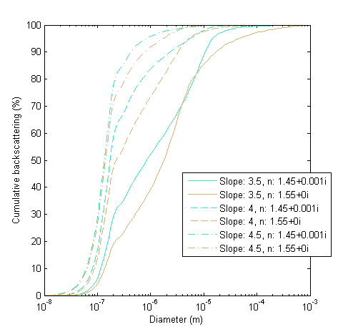
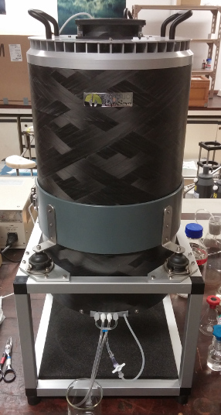
Flow cytometry: characterizing particles towards the submicron scale
Jacopo Agagliate, David McKee
Physics Department, University of Strathclyde, 107 Rottenrow, Glasgow, G4 ONG, Scotland – jacopo.agagliate@strath.ac.uk
The inherent optical properties (IOPs) of natural waters are strongly influenced by the particle size distribution (PSD) and material composition (refractive indices).
However, PSD measurements typically cover limited portions of the particle size range. Current measurement techniques do not achieve direct determination of the PSD over the entire optically significant range ^{[1]}, which recent research puts between 0.05 and 2000 μm ^{[2]}.
In particular, technical limitations hamper reliable determination of the PSD at the submicron scale. This is also the fraction of the size range which models suggest has the greatest influence on the backscattering coefficient b_{b} ^{[2][3]}, an important parameter for ocean colour remote sensing.
In an effort to characterize particles towards the submicron scale, we employ an imaging flow cytometer, the CytoSense (CytoBuoy, Woerden, Netherlands).
Fig. 1 (up) - In most cases, small particles up to 1 μm are responsible for most of the backscattering.
Fig. 2 (right) - The CytoSense flow cytometer.
1

Slide 2
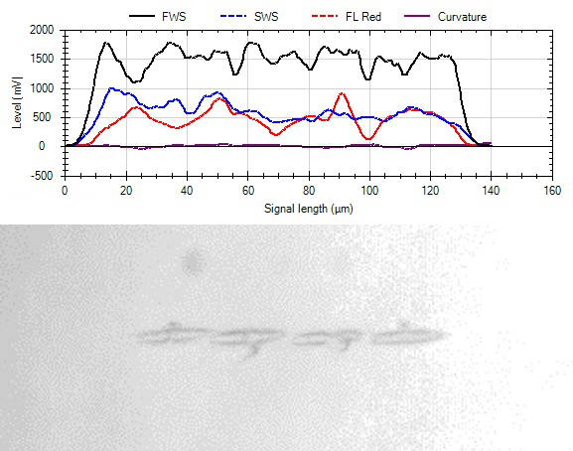
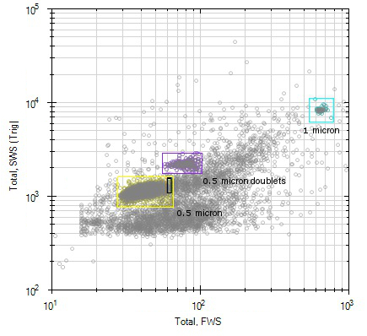
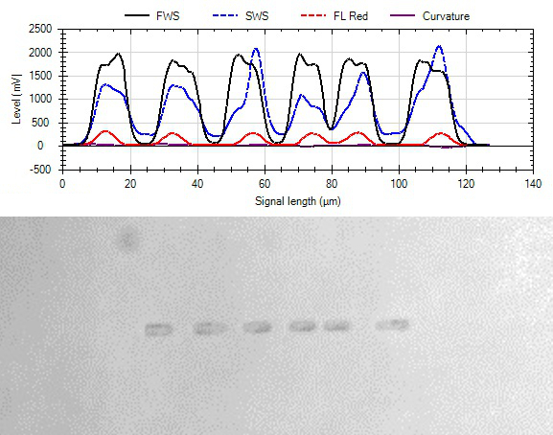
The CytoSense combines high-sensitivity laser light scattering and fluorescence pulse shape characterization capabilities with direct imaging of the particles.
The instrument is able to resolve particles down to 1 μm in diameter, and reaches 0.5 μm in the case of high refractive index polymer beads.
For optical modelling, we would also like to resolve material composition within the PSD (e.g. mineral particles, detritus, phytoplankton, etc.). To achieve this, we use two approaches.
In the first we employ the capability of the CytoSense to record entire pulse profile shapes, unlike simple counters which only offer a discrete impulse when a particle passes through.
Pulse profiles give us information about the actual structure of the sampled particles and can be used in conjunction with the imaging capabilities of the instrument to distinguish, for example, between similar sized phytoplankton species.
Fig. 3 (top) - The CytoSense discriminates a range of sizes down to 1 μm in four different bead samples.
Fig. 5a (top) 5b (bottom) - Pulse profiles and corresponding pictures for similar sized specimens: Pseudonitzschia seriata (a) and possibly a Skeletonema spp. (b).
Fig. 4 (bottom) - 0.5 μm polymer beads. Note scale change as a different sensitivity setting was used.
2

Slide 3
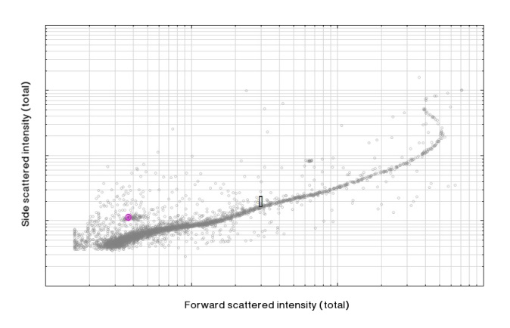
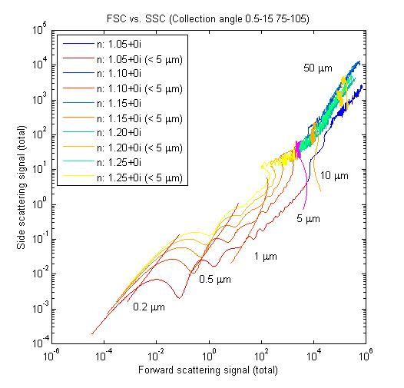
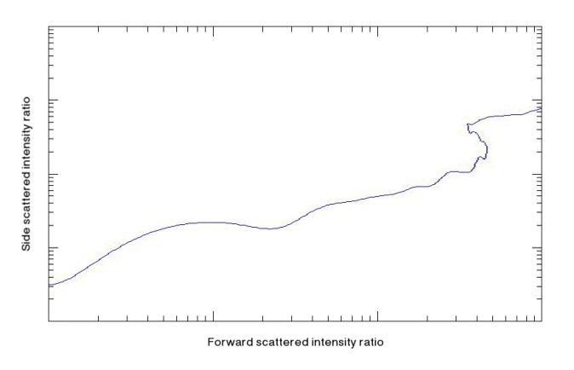
In the second approach we use Mie theory to develop a model that can map data from the flow cytometer. Under assumptions of particle sphericity and known refractive index and size, Mie theory lets us calculate the angular distribution of light scattered by the particle. By running the model for a range of sizes and refractive indices we produce a grid of curves to which we can map measured data.
However, this is possible only if the validity of the approximations introduced in the model holds true, e.g. Mie theory can’t be applied rigorously for particles longer than the width of the laser beam in the cytometer, and an empirical correction has been developed to compensate.
Future developments:
Strongly non-spherical particles will require advanced methods such as the discrete dipole approximation (DDA)^{[4]} or the improved geometric optics method (IGOM)^{[5]}, both designed to account for light interaction with non-spherical shapes.
[1] Reynolds, R. A., D. Stramski, V. M. Wright, and S. B. Woźniak, Measurements and characterization of particle size distributions in coastal waters, J. Geophys. Res., 115, C08024, doi:10.1029/2009JC005930. (2010)
[2] E. J. Davies, D. McKee, D. Bowers, G. W. Graham, W. A. M. Nimmo-Smith, Optically significant particle sizes in seawater, Applied Optics, Vol. 53, Issue 6, pp. 1067-1074. (2014)
[3] Ulloa, O., S. Sathyendranath, and T. Platt, Effect of the particlesize distribution on the backscattering ratio in seawater, Appl. Opt., 33, 7070–7077. (1994)
[4] M. A. Yurkin and A. G. Hoekstra, The discrete dipole approximation: an overview and recent developments, J. Quant. Spectrosc. Radiat. Transfer 106, 558–589 (2007).
[5] P. Yang and K. N. Liou, Geometric-optics-integral-equation method for light scattering by nonspherical ice crystals, Appl. Opt. 35, 6568–6584 (1996).
Fig. 7a (top) 7b (bottom) – (a) Measured scattering data from a suspension of oil droplets. (b) Projected scattering signals using Mie theory for droplet sizes between 0.5 and 5 μm.
Fig. 6 – A theoretical mapping of size and refractive index based on Mie theory modelling. In practise, a compensation scheme is required for particles greater than 5 μm. Additional information from pulse profiles can be used to inform this process.
jacopo.agagliate@strath.ac.uk
3

