Slide 1



Ecological Genomics of Hadal Amphipods
Heather Ritchie¹, Alan J. Jamieson² and Stuart B. Piertney¹
1 Institute of Biological and Environmental Sciences, University of Aberdeen
2 Oceanlab, University of Aberdeen,
1.

Slide 2
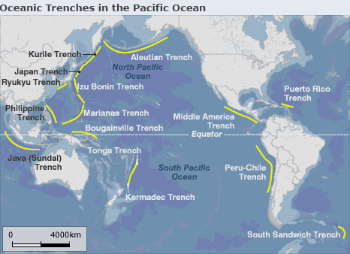
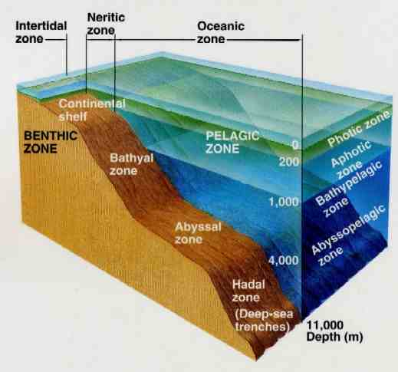

37 Hadal trenches
~75% Pacific Rim
Traditionally thought of as hotspots of endemism but some hadal species have a cosmopolitan distribution.
To what extent is there connectivity between hadal trenches?
Hadal Zone <6000m
Hadal trenches form along subduction zones
2

Slide 3
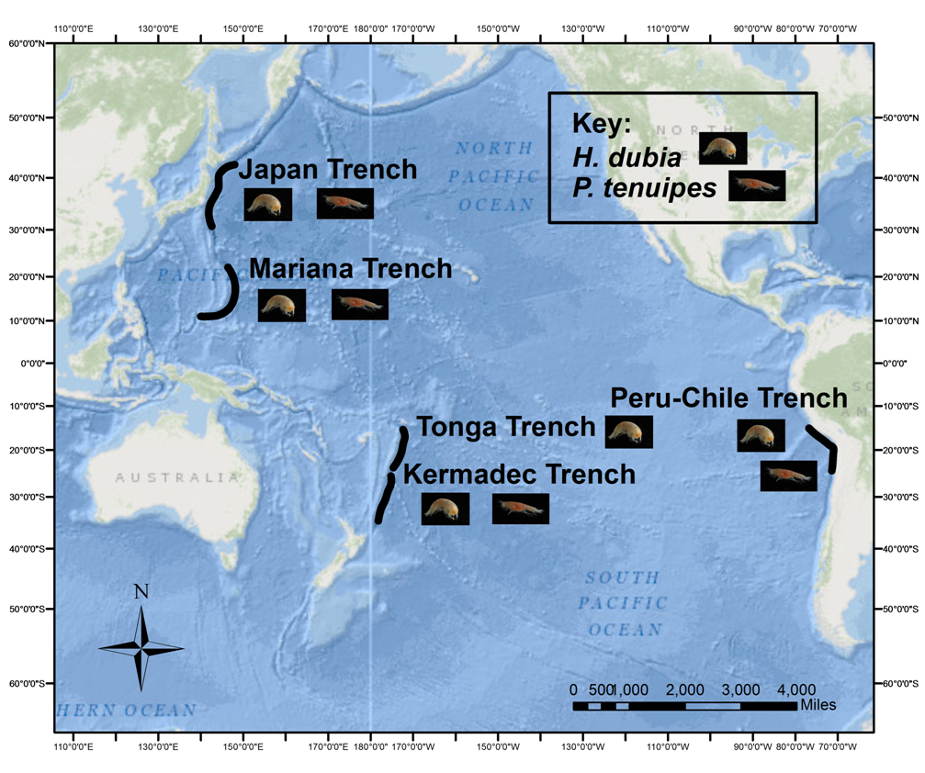
To date…
The challenge now is to understand levels of, and mechanisms for, emigration out of the hadal zone, and dispersal across abyssal oceanic regions
Population structure of two key amphipod species using neutral markers and mitochondrial DNA sequence polymorphism
Preliminary data suggests connectivity between trench populations
The Future…
Use emerging genomic approaches to examine genetic diversity and patterns of divergence
Examine signatures of selection and adaptation and further our understanding of phylogeographical structure
3

